Slide 1
Cloud Computing Architecture And Management

Slide 2
Cloud Computing Architecture shows how cloud systems are built and work
It includes all the parts that are needed to run cloud services smoothly.

Slide 3
It is a mix of two concepts:
SOA (Service-Oriented Architecture) – focuses on using different services to build applications.
EDA (Event-Driven Architecture) – focuses on reacting to events or changes in the system.

Slide 4
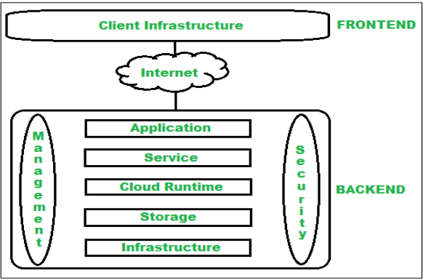
Main Components of Cloud Architecture:

Slide 5
Client Infrastructure –
Devices used to access the cloud (like laptops, phones).
Application –
A cloud application is software that runs on cloud infrastructure and can be accessed through the internet from any device

Slide 6
Service –
The functions or features provided (like storage, email).
Runtime Cloud –
The platform where services run

Slide 7
Storage –
Where data is stored in the cloud.
Infrastructure –
The physical hardware (servers, networks) used by cloud providers.

Slide 8
Management –
Tools to manage and monitor cloud systems.
Security –
Protects data and services from unauthorized access

Slide 9
Internet:
Acts as a bridge between frontend and backend for communication.
Database:
Stores structured data using cloud databases like:
Amazon RDS
Azure SQL Database
Google Cloud SQL

Slide 10
Networking:
Provides network services such as:
Load balancing
DNS
Virtual Private Networks (VPN)

Slide 11
Two Main Parts of Cloud Architecture:
Frontend –
What the user sees and interacts with (browser, app, etc.)
Backend –
The cloud system behind the scenes (servers, storage, databases, etc.)

Slide 12
Frontend (Client Side)
Frontend means the user side of cloud computing.
It includes all the interfaces and applications the user uses to access the cloud.
Example: Using a web browser to open a cloud-based app

Slide 13
Backend (Cloud Side)
Backend is the cloud system used by the service provider.
It handles storage, servers, virtual machines, security, and traffic control.
Manages services and resources in the cloud.

Slide 14
Components of Cloud Architecture
Frontend Components
Client Infrastructure:
The user’s device, browser, or app.
Provides a GUI (Graphical User Interface) to interact with the cloud.

Slide 15
Backend Components
Application:
Software in the backend that the user wants to access (e.g., Google Docs).
Service:
Manages the 3 cloud service models:
SaaS – Software as a Service
PaaS – Platform as a Service
IaaS – Infrastructure as a Service

Slide 16
Analytics:
Helps analyze data using:
Data warehousing
Business Intelligence (BI)
Machine Learning (ML)

Slide 17
Examples of Cloud Architecture in Real Life
Online Store – Amazon/Flipkart
Users shop online using frontend (app or website).
• Cloud handles:
Shopping cart
Payments
Inventory updates
Backend runs on AWS Elastic Beanstalk, stores photos in Amazon S3.

Slide 18
Mobile App – Food Delivery (Zomato/Swiggy)
• App interface is frontend (ordering food).
• Cloud backend manages:
Order tracking
Restaurant notifications
Payments
Uses Firebase and Google Cloud/AWS to store data and run servers.

Slide 19
Benefits of Cloud Computing Architecture
1.Makes cloud systems simple and easy to use
2. Helps in fast data processing
3. Provides strong security
4. Makes the system modular (easy to manage and update)

Slide 20
5. Better disaster recovery during failures
6. Gives easy access to users from anywhere
7. Reduces IT costs
8. Offers high reliability
9. Supports scalability (easy to grow when needed)

Slide 21
THANK YOU

